Slide 1
Sentimental Analysis of Movie Reviews
By Karma Tsering
Notes:
Good evening everyone thank you for coming to my talk
Today I am going to talk about sentimental analysis with emphasis on NLP using spacy and word2vec
My name is Karma and this is my final project

Slide 2
Table of content
Motivation
What is the problem I am attempting to solve?
About the data
Data munging
Technical tools used:
Natural language processing (spaCy): to process the data and to create features
word2vec (Continuous Bag of Words): converting words to vectors
Neural Network: to analyze the data
Analysis: models used
Conclusion: result
Future work
Notes:
List of things to talk about

Slide 3
Motivation
Businesses must know how their customers “feel” about them
What they are saying
How they are saying it
Good news: information is available
2.5 Quintillion bytes every day
Bad news: too many and too expensive
Notes:
The best businesses understand their customers, which means to say that they understand how they feel
What they are saying about them and just as important how they are saying it.
The good news is the information the businesses need is available:
2.5 Quintillion bytes every day
And large part of it is text based: people texting, communicating, reviewing, blogging, writing, memeing, diaries, court filings and many more
measure the impact of a new company action such as new product, ad campaign, or news.
The bad news is there are too many information.
Movie rating doesn't capture the nuances of the opinions and no one wants to sit and read thousands of reviews. Which can become expensive really fast.

Slide 4





Motivation
Rating capture limited information
Service, venue, appearance, pricing, product
sentiment analysis of reviews
Notes:
Ratings system tries to capture that sentiment in nice neat, simple and easy way to understand
But it does not Capture the whole picture,
The rating and the review don’t always match
These insights can be used to make business decisions such as direct marketing, recommendation system, and future project directions.
sentiment analysis is very important source of information, that's why many companies have invested a lot of resources
such as Amazon Twitter IBM and google
But for this presentation I'll be focusing on the information gleaned from the text and comparing them to the information glean from the rating system

Slide 5
About the IMDb data
This data was collected by Christopher Potts in 2011
It has 50,000 reviews
25k train and 25k test sets
25k pos and 25k neg
Collected my own data from IMBd, using scraper called scrapy, of a new movie for testing purposes.
Positive > 7 and Negative < 4
Notes:
Data used for this project was collected by Christopher Potts in 2011 and I used all of it for training my model and collected my own data from IMDb, using scraper called scrapy of a new movie, for testing purposes.
This dataset contains 50,000 reviews split evenly into a 25k train and 25k test sets, and each review is in individual files. The overall distribution of labels is balanced (25k pos and 25k neg),
Movie reviews are subjective attitudes, emotions and opinions of people and a sentiment analysis extracts information from these reviews.
This sentiment analysis will neatly categorize people's sentiment as positive and negative.
Reviews with rating of 7 or greater was labeled as positive And review with 4 or less rating was labeled as negative

Slide 6
Cleaning the review text
Moved reviews from individual files to a pandas data frame
File name
assigned label
Clean the data using
Regular expression operations (re)
beautiful soup
NLTK
python functions.
Capture the contextual meaning
Word2Vec neural network expects documents in list of list format
Notes:
First I move the reviews from each individual files to pandas data frame and added 2 new feature columns; the file name (which will be used later) and the assigned sentiment label.
I cleaned the data using Regular expression operations (re), beautiful soup, NLTK and python functions.
Since we need to capture the contextual meaning of words in the documents, when cleaning the data I need to be careful not to remove too much so as to lose the contextual meaning, such as the stop words.
Word2Vec neural network expects documents in list of list format

Slide 7
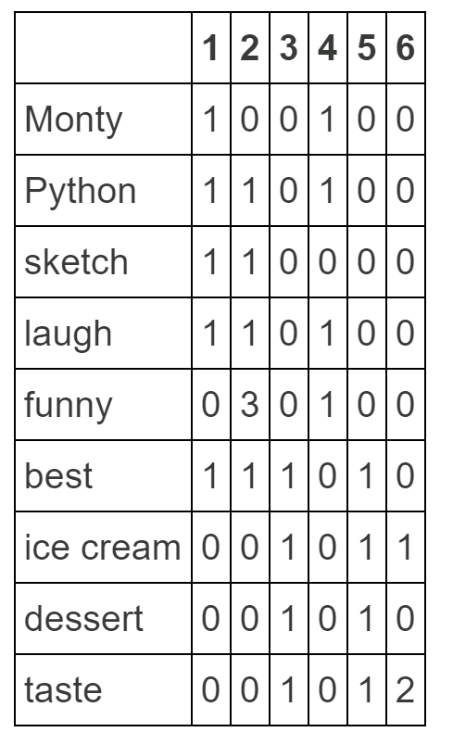
Word2Vec
One-hot-encoding
The meat of this project is a shallow neural network called word2vec.
Words into vectors
Word2vec vs. earlier method : word embedding
Probabilistic relation between the words .
Equidistance from each other.
Notes:
The meat of this project is a shallow neural network called word2vec.
Here I want to show how to Word2vec works
Word2vec is a vectorizer, two-layer neural network that takes in text and outputs their vectors.
The key difference between word2vec and the other vectorizer (e.g. frequency, tf-idf, one-hot-encoder) is the word embedding, which says something about the relation between the words probabilistically. Other vectorizers lose the ordering of the words and they also ignore semantics of the words because words' vectors are equidistance from each other.
For example one-hot-encoding (a.k.a countvectorizing) is a method of transforming words into vectors by counting the occurrence of the words in each document.

Slide 8
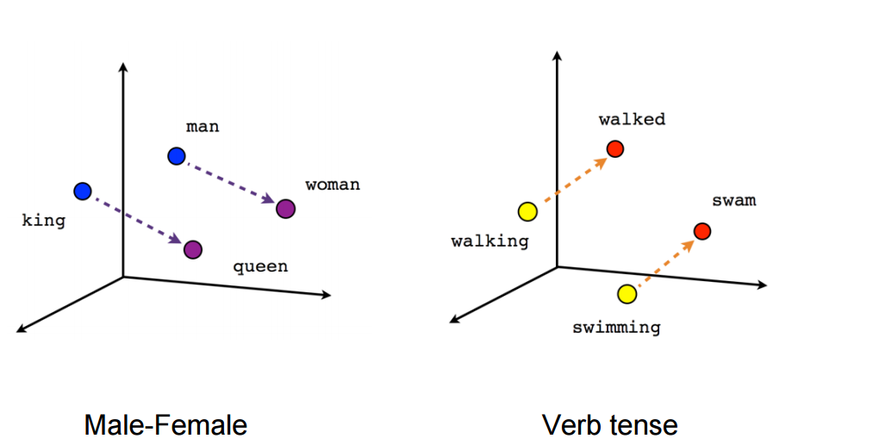
Word embedding
King – man + queen = ?
Notes:
On the other hand
As mentioned earlier word2vec takes advantage of vectors which as both magnitude and direction to capture the contextual meaning other words.
To illustrate the advantage, one of the most common example is king – man + queen = ?

Slide 9
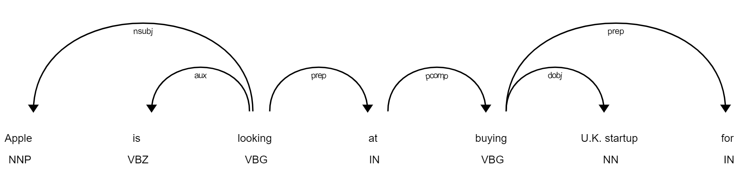
Vectorization
Notes:
Vector of a word is influenced by words around it. Suppose the word “looking” has some value it will be change by the word is, apple, at and buying.

Slide 10
Average the vector
Build class to take the average of each review vector to represent that review
Now that we have vector representation of the words in our corpus, we need to use it to create vector representation of the documents to pass it into the classifier neurol network. One way to do that is to take the average of the word vectors in the documents and use the averaged word vector to reprsent the documents.

Slide 11
Graph the result of Word2Vec
Gridsearch
tsne
How good is this vector representation? show this using graphs Hey Zack I am having trouble graphing this so I will do it later moving on to doc2vec

Slide 12
Word2Vec to Document Vector
Averaged
0 | once | 0.40 | 0.21 | -0.29 | 0.32 | 0.15 | -0.51 | 0.54 | 0.02 | -0.35
1 | again | -0.63 | -0.32 | 0.29 | 0.80 | 0.32 | 0.99 | 0.07 | 0.00 | -1.31
2 | mr. | 0.14 | 0.30 | 0.54 | 0.32 | 0.35 | -0.74 | -0.39 | 0.00 | -0.36
3 | costner | 0.51 | 0.43 | 0.48 | 0.35 | -0.11 | -1.02 | 0.49 | -0.16 | 0.33
4 | has | 0.38 | 1.23 | 0.30 | 0.53 | 0.18 | -0.08 | 0.96 | -0.47 | -0.27
avg. | Doc1 | 0.16 | 0.37 | 0.26 | 0.46 | 0.18 | -0.27 | 0.34 | -0.12 | -0.39
doc2vce
doc2vce
Doc1 | 0_2.txt | 0.40 | 0.21 | -0.29 | 0.32 | 0.15 | -0.51 | 0.54 | 0.02 | -0.35
Doc2 | 10000_4.txt | -0.63 | -0.32 | 0.29 | 0.80 | 0.32 | 0.99 | 0.07 | 0.00 | -1.31

Slide 13
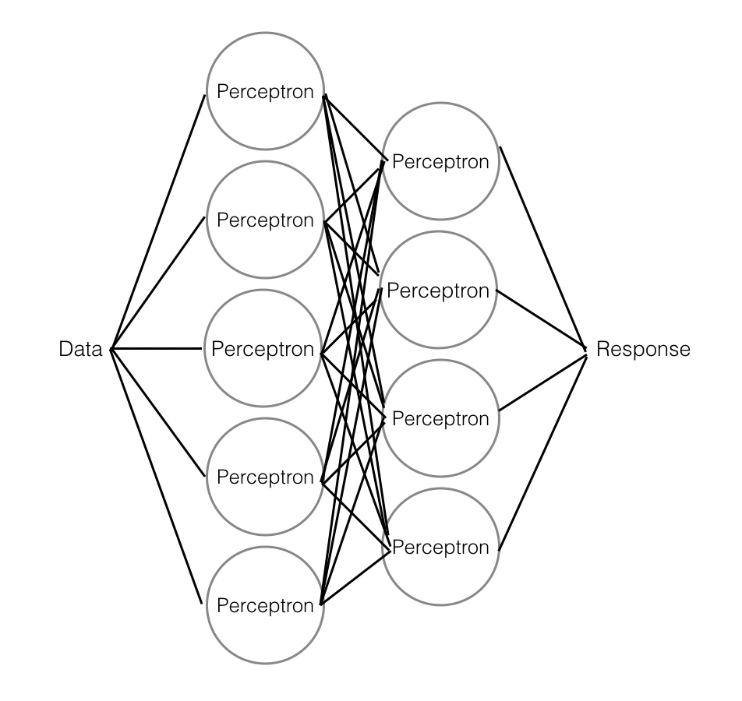
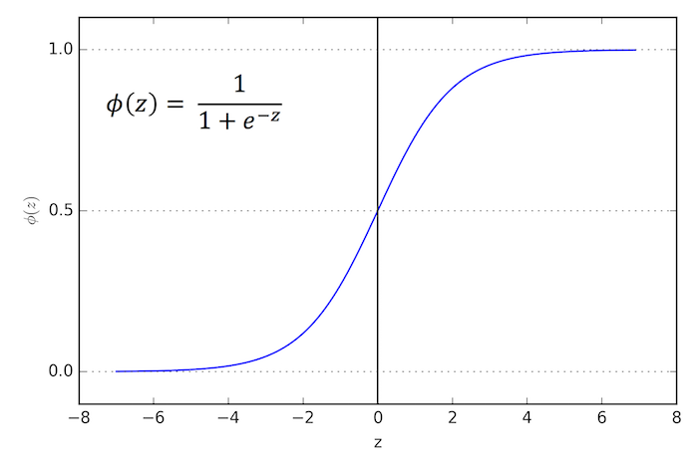
Analysis: models used
MLP
Logistic regression
features vs. probability of particular outcome
It’s a classification model
ensemble
Boosting
Notes:
Method
models

Slide 14
Results: Word2Vec
Input : print(model.wv.most_similar('great’))
Output : ('wonderful', 0.7530227899551392),
('terrific', 0.7318073511123657),
Which word doesn’t belong?
Input: ("awesome bad awful terrible") Output: “awesome”
Input: ("nice pleasant fine excellent") Output: “pleasant”
Classic test
Input: King – man + queen = ? Output: ('princess', 0.4177)
Notes:
result

Slide 15
Optimized MLP
 | precision | recall | f1-score | support
POSITIVE | 0.50 | 0.50 | 0.50 | 6192
NEGATIVE | 0.51 | 0.50 | 0.50 | 6321
micro avg | 0.50 | 0.50 | 0.50 | 12513
macro avg | 0.50 | 0.50 | 0.50 | 12513
weighted avg | 0.50 | 0.50 | 0.50 | 12513
Optimized Logistic
 | precision | recall | f1-score | support
POSITIVE | 0.64 | 0.65 | 0.64 | 12296
NEGATIVE | 0.65 | 0.64 | 0.65 | 12704
micro avg | 0.64 | 0.64 | 0.64 | 25000
macro avg | 0.64 | 0.64 | 0.64 | 25000
weighted avg | 0.64 | 0.64 | 0.64 | 25000

Slide 16
Future work
Different model
Clustering before modeling: rating does not match review
Lager corpus
In-depth analysis of the weight of the review

Slide 17
Thank you

Slide 18
Task list
Importing the data
Cleaning the review text:
Regular expression operations (re): removed spicfied strings
beautiful soup: HTML tags
NLTK: parts of speach
python functions
Vetorizing using Word2Vec:
Test vectors
Graph word vectors:
Reduce vectors to two dimension using tsne
Average the vectors of words in the documents to create document vectors representation
Creat a classifier Multi level preceptron (MLP) model using the documents vectors
model was run for few different hyperparameters with activation='relu' due to lack of resouces
gridsearch was run for hyperparameter with activation='logistic' on differen computer.
Try out ELM
Vetorization using Doc2Vec
Test vectors
Unable to graph
gridsearch

Slide 19
Part-of-speech tagging
Homonyms
Tire - to grow fatigued / a part of a wheel
Notes:
Vector of a word is influenced by words around it. Suppose the word “looking” has some value it will be change by the

Slide 20
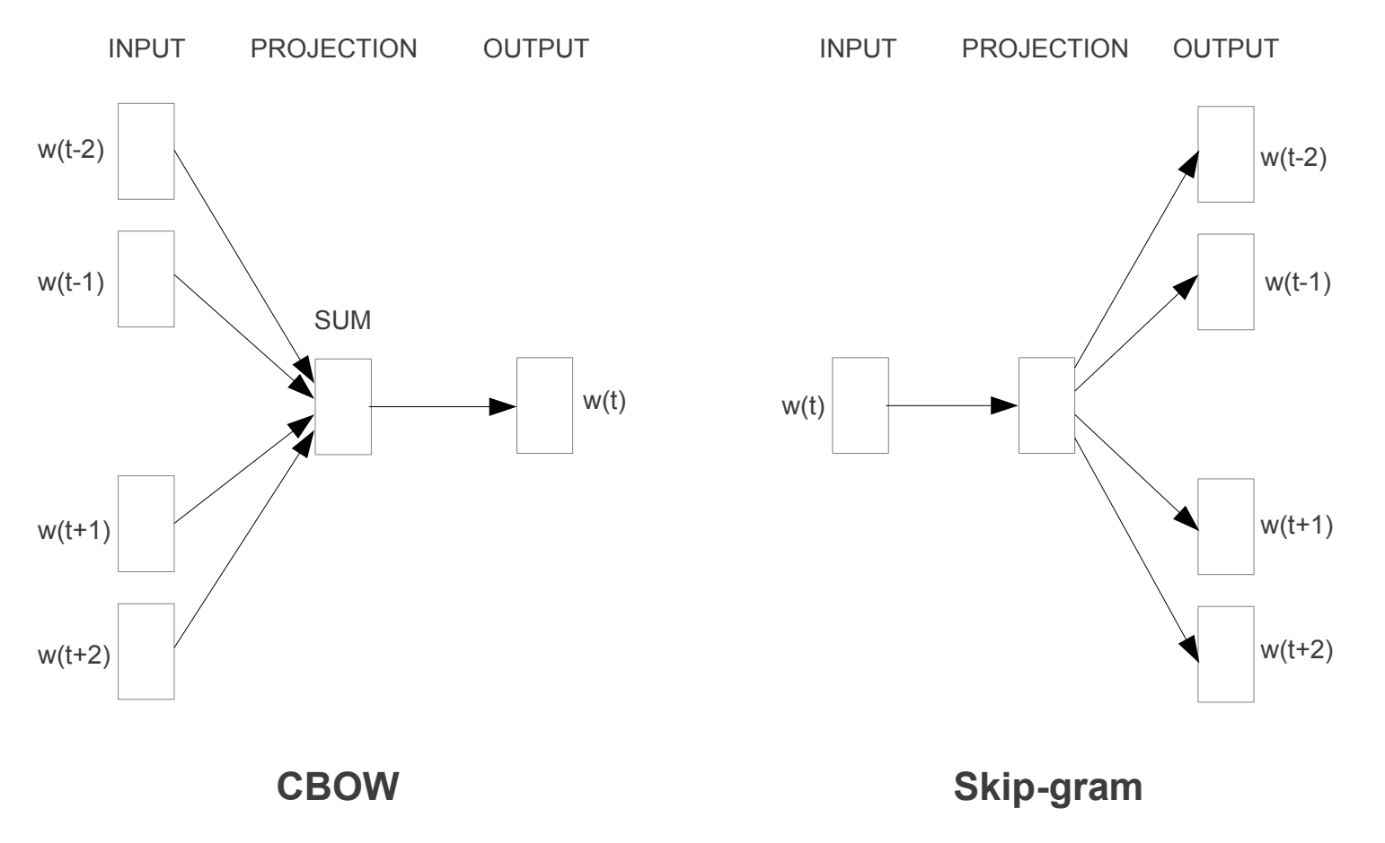
Vector Generator
Notes:
Example of a hyperparameter

Slide 21
Word2Vec hyperparameter
workers=4, # Number of threads to run in parallel
min_count=10, # Minimum word count threshold.
window=6, # Number of words around target word to consider.
sg=0, # Use CBOW because our corpus is small.
sample=1e-3 , # Penalize frequent words.
size=300, # Word vector length.
hs=1 # Use hierarchical softmax.

Slide 22
NLP processed each review
NLP tokenenizes tex, meaning it segments the text into individual words and annotations, and returns iterable processed Doc with all the information of the original text.
Using this to creat list of review list

